Slide 1
Welcome Miquella de Boer, Premier Field Engineer

Slide 2
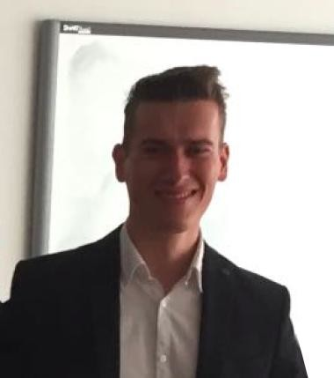
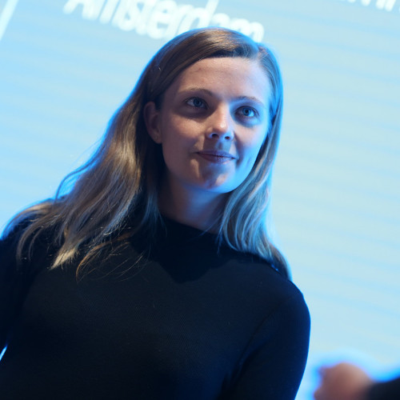
Welcome
Dennis Eikelenboom
Delivery Data Scientist
Miquella de Boer
Premier Field Engineer

Slide 3
Welcome
Dennis Eikelenboom
Delivery Data Scientist
DevOps and ML Engineer
Miquella de Boer
Premier Field Engineer
Data Scientist

Slide 4
Agenda Day 1
Morning: Platform Introduction
Introduction to the AI Platform
Azure Machine Learning conceptually
Azure Machine Learning workspaces
Azure Machine Learning tools and interfaces
Afternoon: Running Experiments
Experiment Tracking
Managed Compute
Unattended Remote Execution (parallel)
Hyperdrive

Slide 5
Agenda Day 2
Morning: Pipelines
Pipelines conceptually
Pipeline Experiments
Publishing pipelines
Afternoon: Model Management
Artifact Store
Model CI/CD

Slide 6
Agenda Day 3
Morning: Azure ML in the enterprise
Governance
Security
Custom Roles
Afternoon: Azure ML Datasets
Datasets
Event-based triggering of ML workflows
Digital Audit Trail
Labelling

Slide 7
Introductions
Name?
Department?
Role and typical job activities / projects?
Learning goal for the three days?
Biggest challenge while doing data science?

Slide 8
Logistics
Monday, Tuesday, Wednesday
Time: 10h – 16h
Lunch time? Breaks?
10 min break every 50 min (from 10.50-11.00 ect.)
Lunch 12.00 -13.00
Important calls or emails? No problem. Questions? Please raise!

Slide 9
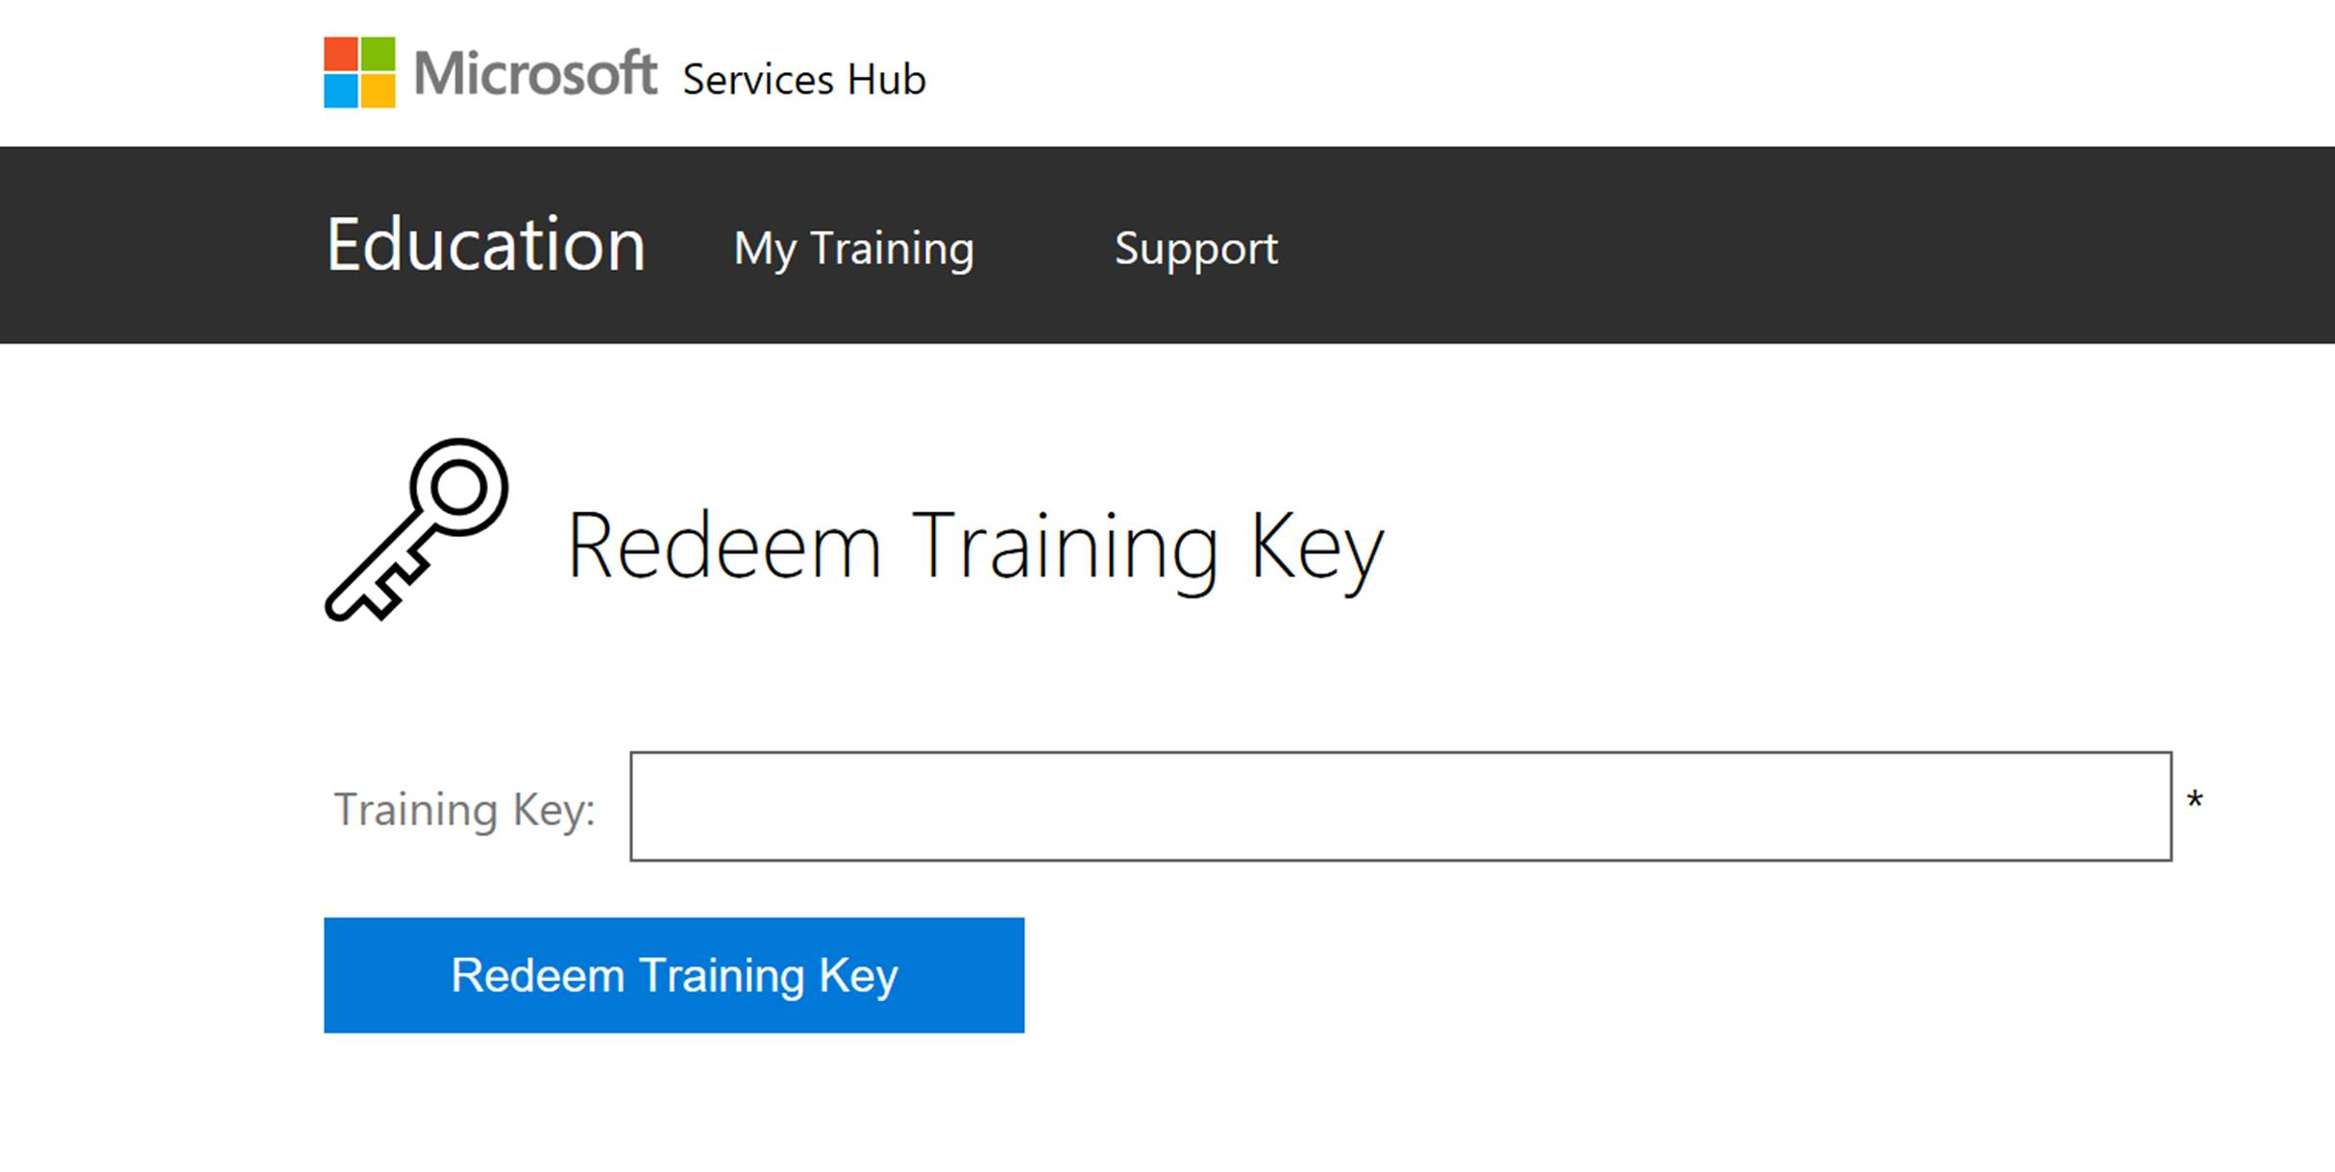
Labs
Go to: https://aka.ms/premiereducation
Login with personal account
Go to: WorkshopPLUS → my training → redeem training key
Key: 81ED98B7

